Slide 1
HTML & CSS
Workshop
Scott Zou
09/25

Slide 2
What is HTML?
HTML is a markup language for describing web documents (web pages).
HTML stands for Hyper Text Markup Language
markup means stuff are described by HTML tags

Slide 3

What is Tag
keywords (tag names) surrounded by angle brackets:
Usually Come in pairs （start tag, end tag)
End tag has a slash

Slide 4
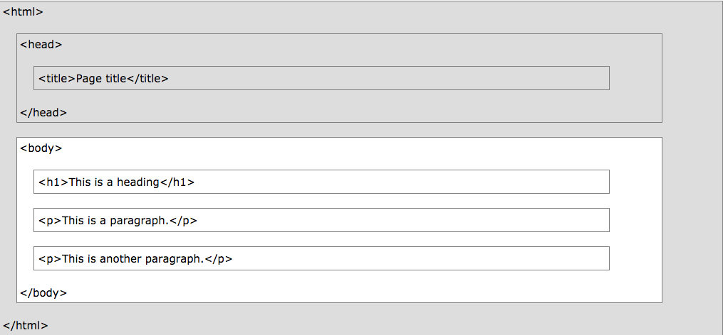
A Example Page
White Area gets displayed

Slide 5

Try it yourself
https://docs.google.com/document/d/1mMF4AFee4ogSsPmnOroaSLEQqXEiKOXtrckfWs4VH68/edit
Should be in the shared folder

Slide 6

Different Headings
<h1>This is a heading</h1>
<h2>This is a heading</h2>
<h3>This is a heading</h3>

Slide 7

Links
<a href="url">link text</a>
Whatever’s inside is linked
Tag has attributes: href is an example

Slide 8


Lists
ul for unordered lists, ol for ordered

Slide 9

Image
src is where the file is
alt is what gets to displayed if the image doesn’t load

Slide 10
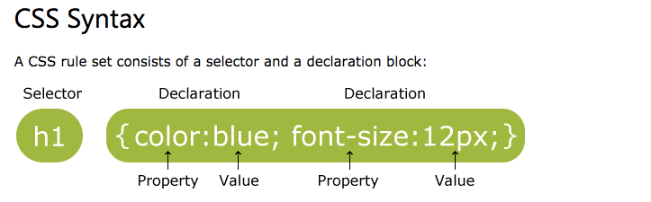
CSS
CSS stands for Cascading Style Sheets

Slide 11
Some Example
background-color
color
text-size
margin
size
etc.

